Slide 1
Introduction of Docs GUI automation and Automation infrastructure

Slide 2
Agenda
GUI Test Automation
Test Grid
Test Dashboard
Test Log Collector for DOH

Slide 3
GUI Test Automation
Library: Selenium + JUnit
Simple configuration
Supported Browsers: IE 9, Firefox, Chrome
Parallel test with Selenium Grid
Notes:
3

Slide 4
Get Started
Use RTC to load source code as Eclipse Project
  Stream: SCMainStream Docs
  Path: concord_base/IBMDocsAutomation/testgui
Make sure at least one of Firefox, Chrome And IE9 installed
Java 1.7+
Choose one JUnit test class to run

Slide 5
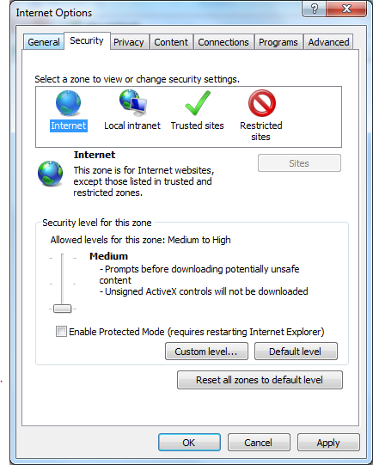
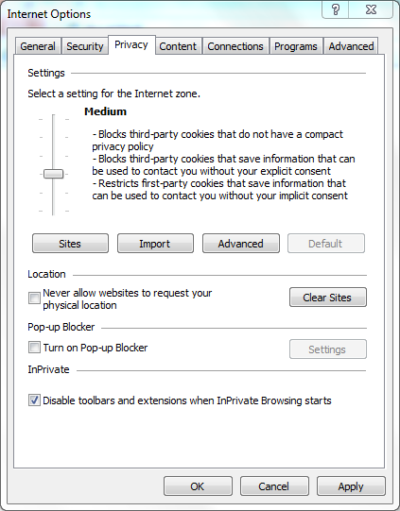
Configure IE9
Set “Enable Protected Mode” for each zone to be the same value
Disable Pop-up Blocker
Notes:
5

Slide 6
Run Test from Command Line
com.ibm.docs.test.common.JUnitRunner
Run any JUnit test from command line
Scripts are available in testgui/bin
Run tests by class
  run -n test-name -tc com.ibm.docs.test.gui.cases.document.Basic
Run tests by package
  run -n test-name -tp com.ibm.docs.test.gui.cases.document
Run tests by suite file (qualified class name line by line)
    run -n test-name suite.file
Run tests in parallel
    run -n test-name -p 5 -tc com.ibm.docs.test.gui.cases.document.Basic
Add –Dprop.name=prop.value to overwrite System properties
    run -n test-name -Dtestspace=c:/testspace -tc com.ibm.docs.test.gui.cases.document.Basic

Slide 7
Advanced Configuration
config/default.properties or system properties
# Include the test server configuration
include=http://concordla.cn.ibm.com/config/docs03.server
# Execute testing with browsers in Selenium Grid
#browser=http://concordla.cn.ibm.com:4445/wd/hub,firefox
# Execute testing with local browsers
browser=any
# Sleep factor. If network is slow, enlarge the value to improve stability
#sleep.factor=1
# Rerun count if test is failed
#rerun=1
# Set rerun interval %seconds
#rerunInterval=0
# The max run time of one test case
#timeout=-1
# enable javascript debug
#javascript.debug=false

Slide 8
Test Report and Log
Monitor progress
Screenshot when failures occur
Location
  ${testspace}/report.html
    http://concordla.cn.ibm.com/testdashboard/execution/odwHu_vOeWc9YzYRUQ5KEA/report.html
  ${testspace}/${test.name}/log.html
    http://concordla.cn.ibm.com/testdashboard/execution/odwHu_vOeWc9YzYRUQ5KEA/com.ibm.docs.test.gui.cases.document.Basic-saveAs/log.html

Slide 9
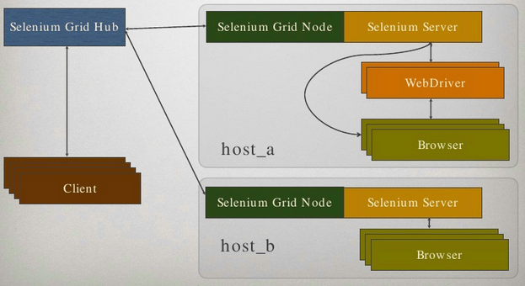
Selenium Grid

Slide 10
Selenium Grid
Scale by distributing tests on several machines ( parallel execution )
Manage multiple environments from a central point, making it easy to run the tests against a vast combination of browsers / OS.
Docs Selenium Grid
  50VMs
  Grid Console
    http://concordla.cn.ibm.com:4444/grid/console

Slide 11
Develop GUI Test
1
Define UI Elements in PageObject
2
Implement Test with JUnit

Slide 12
PageObject
com.ibm.docs.test.gui.pages
Java class to organize UI elements and tasks per web page (need not represent an entire page)
Define UI elements as fields
Wrap reusable steps in methods
extends BasePage

Slide 13
Define UI Elements 1
Add @Find annotation above a field
  Argument by: Expression to locate the element or elements
  Argument timeout: The max time to wait the element for existence
Define one element
@Find(by="id=userName", timeout=30)
  public EnhancedWebElement userNameInput;
Define a list of elements
  @Find("css=#list a.lconnDownloadable")
  public List<WebElement> fileListDownloadLinks;

Slide 14
Define UI Elements 2
Ways to locate elements
  CSS Selector: css=
  Element ID: id=
  XPath: xpath=
  Javascript: script=
  Element Tag: tag=
  Element Name: name=
  Links by Text: link=
  Links by Partial Text : partialLink=
  Class Name: className=
Locate Elements by All: {}+{}
  @Find("{id=myitem}+{css=div.item:nth-child(1)}")
Locate Elements by Chain: {}-{}
    @Find("{css=#itemParent}-{css=.item:nth-child(1)}")
Dynamically locate elements with arguments
  @Find("css=#concordTemplatesDialogResults div[id*='$0']")
  public EnhancedWebElement templateDlgResult;
  public DocumentEditorPage selectTemplate(String templateId) {
  templateDlgResult.setLocatorArgument(templateId);
  templateDlgResult.click();
  templateDlgOk.click();
  return this;
  }

Slide 15
Define Methods
Generally don't make assertions
Return this to enable fluent coding style
Avoid locating elements in methods
Use Log4J to log information
Don’t catch exception, if you have to, re-throw it as a RuntimeException
Generally keep PageObject stateless

Slide 16
Write JUnit Test Class 1
com.ibm.docs.test.gui.cases
JUnit standard annotation
  @Test
  @Before
  @After
  @BeforeClass
  @AfterClass
  @Ignore
extends BaseTest

Slide 17
Write JUnit Test Class 2
Extended annotation provided by Docs automation
  @Drive
  Add it above a PageObject to initialize it
  @TestDoc
  Specify some description for the test
  @TestLink
  Specify a external link for the test

Slide 18
Best Practice
Don’t catch Exception, unless you intend to test the Exception
Avoid complex code
Don’t forget add assertion
Use assertArrayEquals instead of assertEquals for array data
Make test method independent, not affect or be affected by others

Slide 19
Test Dashboard
  http://concordla.cn.ibm.com/testdashboard
Monitor Server Status
Login by one click
Task
Execution
All testing server info is available
  http://concordla.cn.ibm.com/config

Slide 20
SmartCloud Dashboard
SmartCloud Testing Status
  http://vmllela.swg.usma.ibm.com/bvtfvt/Dashboard.php

Slide 21
Test Log Collector for DOH
Upload test result to Test Dashboard
Add <script src="report.js"></script> into the bottom of DOH runner.html
Demo
  Manually upload test result
  http://9.115.43.77/util/doh/runner.html?testModule=tests.rpc
  Automatically upload at the end of test
  http://9.115.43.77/util/doh/runner.html?testModule=tests.rpc&name=testname

Slide 22
Reference
Selenium
  http://code.google.com/p/selenium/
JUnit
  http://junit.org/
Web Tech Learning
  http://www.w3schools.com/
RTC
  http://pic.dhe.ibm.com/infocenter/rtc/v2r0m0/index.jsp

